Slide 1
Shell and a Shell script
The activities of shell are not restricted to command interpretation alone.
The shell has a whole set of commands that can be put together as a language.
A Shell program runs in an interpretive mode. It is not compiled into a separate executable file as a C program .
Each statement is loaded into the memory when it is to be executed.

Slide 2
Shell and a Shell script
Shell scripts consequently runs slowly than those written in high level language.
Using shell is important especially in system administrative tasks.
Concluding statement -
In Unix , the shell is a program that interprets commands and acts as an intermediary between the user and the operating system.

Slide 3
Variables
Shell variables are created once they are assigned a value. A variable can contain a number, a character or a string of characters. Variable name is case sensitive and can consist of a combination of letters and the underscore "_". Value assignment is done using the "=" sign. Note that no space permitted on either side of = sign when initializing variables.

Slide 4
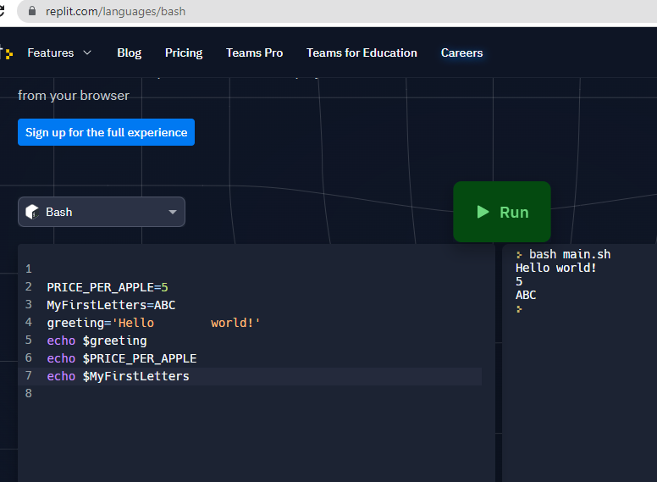
https://replit.com/languages/bash

Slide 5
https://replit.com/languages/bash
MyFirstLetters=ABC
echo "The first 10 letters in the alphabet are: ${MyFirstLetters}DEFGHIJ"
Encapsulating the variable name with "" will preserve any white space values
greeting='Hello world!'
echo $greeting" now with spaces: $greeting"

Slide 6
https://replit.com/languages/bash
#!/bin/bash
# Add two numeric value
sum=(25+35)
#Print the result
echo $sum

Slide 7
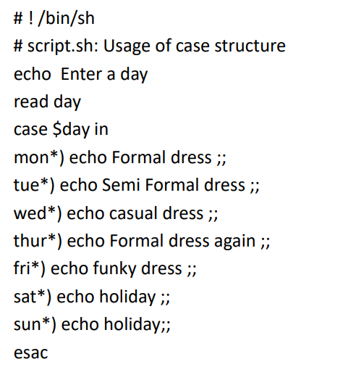

Slide 8
